Slide 1
Green Infrastructure Plans
Tasks and Timelines
November 16, 2016

Slide 2
Let’s Talk About
What are the endpoints?
What goes into a Green Infrastructure Plan?
  Policies
  Processes
  Infrastructure Projects
  Projections of Projects and Loading Reductions
  Outreach and Staff Training
What are the tasks and timelines?
  Framework – adopted by June 30, 2017
  Green Infrastructure Plan – September 2019

Slide 3
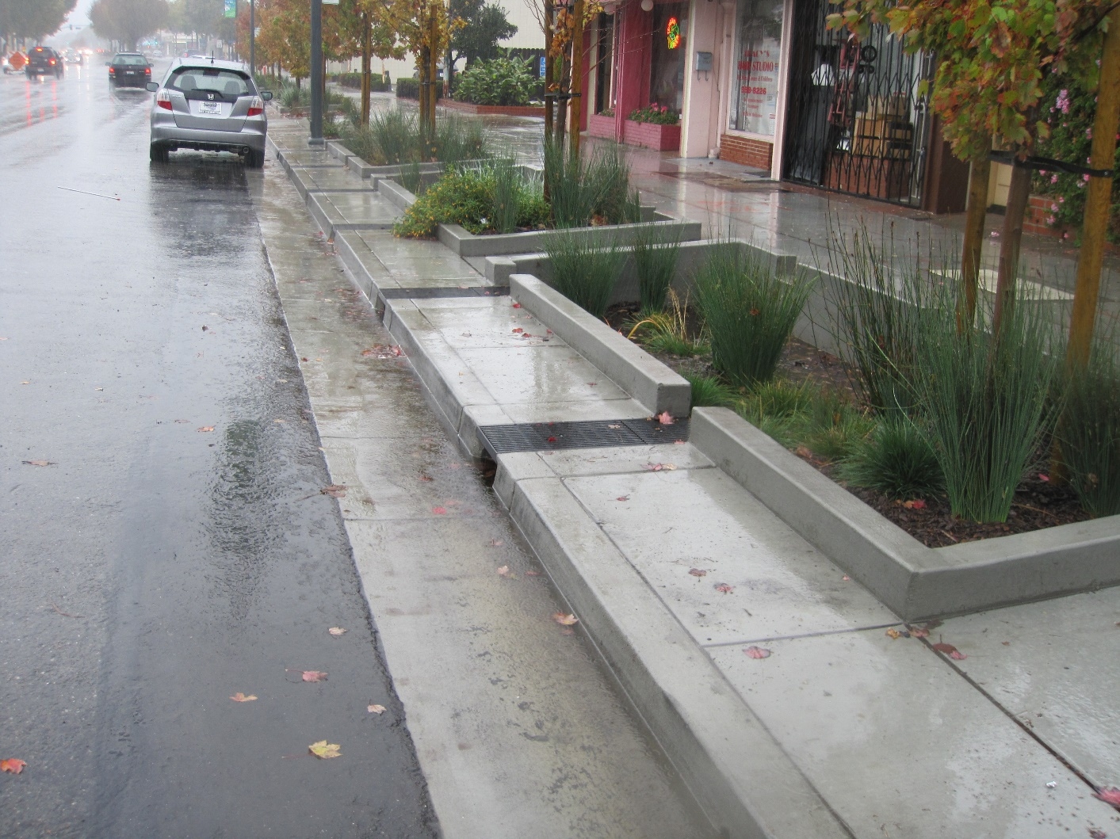
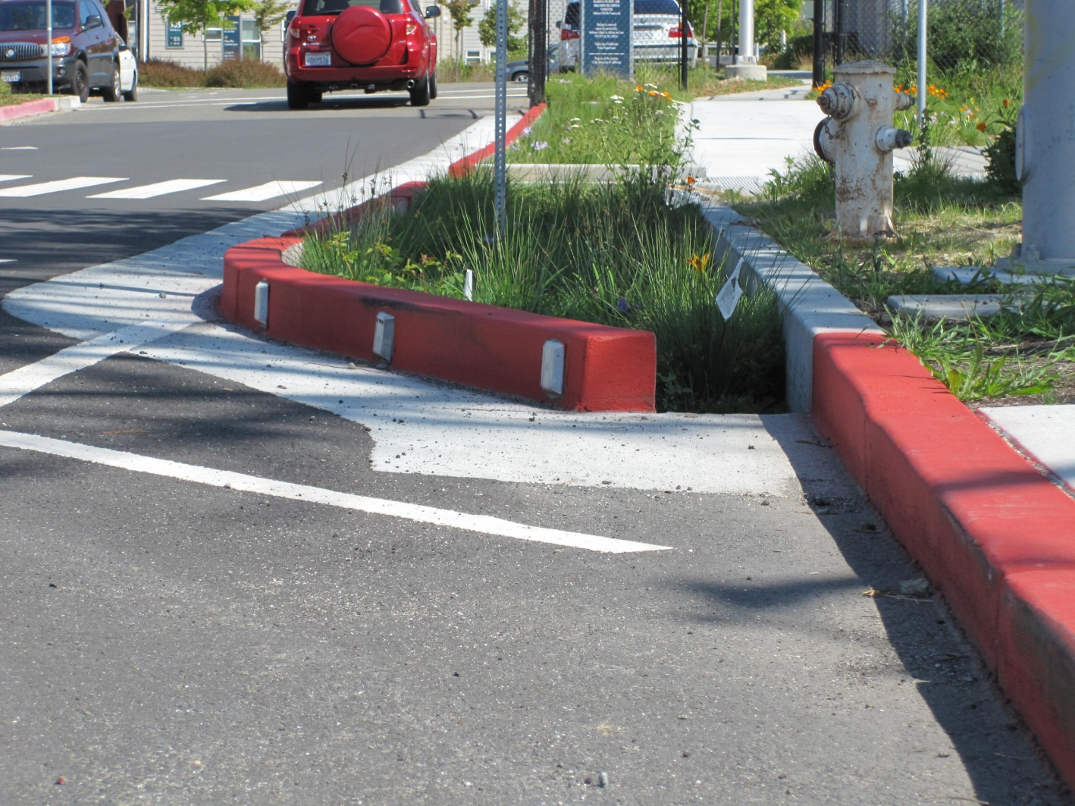
Green Infrastructure: Endpoints
Retrofit projects within street right-of-way

Slide 4
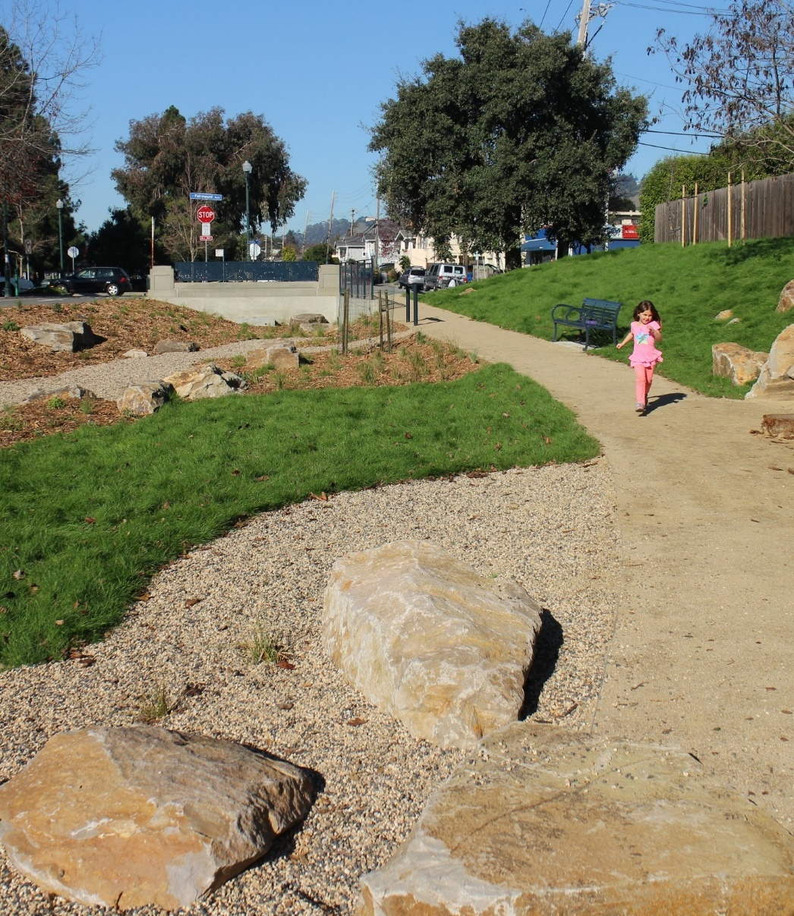
Green Infrastructure: Endpoints
Retrofit projects within street right-of-way
Other projects that divert runoff for dispersal or treatment

Slide 5
Green Infrastructure: Endpoints
Retrofit projects within street right-of-way
Other projects that divert runoff for dispersal or treatment
C.3 implementation on previously developed sites

Slide 6
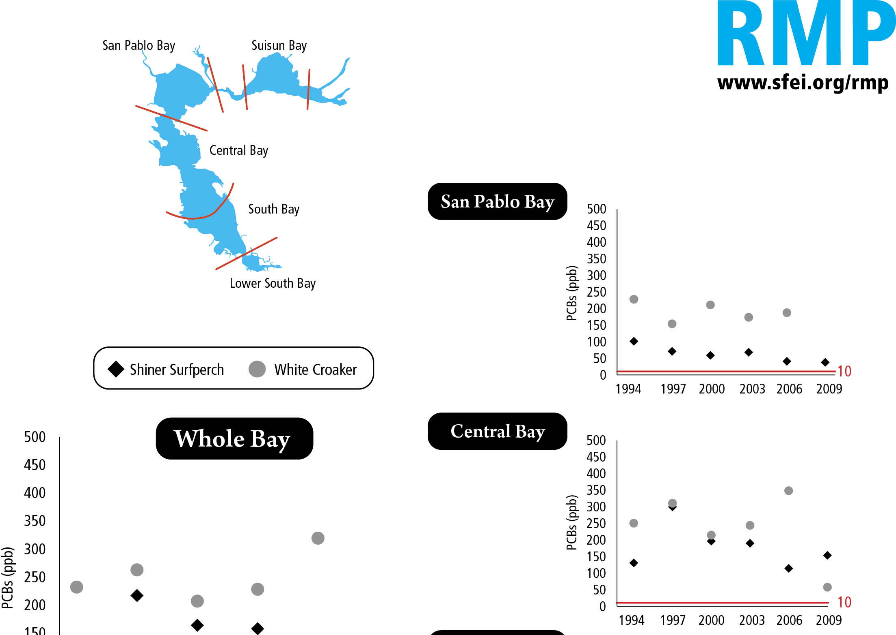
Green Infrastructure: Endpoints
Retrofit projects within street right-of-way
Other projects that divert runoff for dispersal or treatment
C.3 implementation on previously developed sites
Reduced transport of urban sediments

Slide 7
Green Infrastructure Plans
Policies
  Resolutions or ordinances giving direction/authority
  Updates to existing planning documents
Processes
  For reviewing municipal infrastructure projects
  For identifying additional opportunities
  For tracking and mapping projects
  For evaluating load reductions

Slide 8
Green Infrastructure Plans
Projects and Projections
  Maps showing projects and areas to be examined
  Areas projected for redevelopment
  Projected load reductions
Outreach and Staff Training

Slide 9
Tasks and Timelines

